Slide 1
Chapter 3
What Is Politics?

Slide 2
What Is Politics?
Politics is the subset of human behavior that involves the use of power or influence.
Power is involved when people can’t accomplish their goals without:
Trying to influence the behavior of others, or:
Trying to wrestle free of the influence of others.
Politics is therefore not just about the government
Any strategic situation—where two individuals are interdependent on one another’s actions—is potentially political

Slide 3
Game Theory
Politics requires strategic thinking.
Game theory is the study of strategic interaction.
The basic assumption of game theory is that players choose to do what they believe is in their best interest (players are rational and selfish, and assume that others are as well).
All games must have 3 components: players, strategies, and payoffs.
A 4th component—beliefs—is a property of the players themselves. This is key for understanding Nash equilibrium.

Slide 4
Game Theory
The interests/objectives of each player are reflected in the payoffs associated with each outcome of the game.
Each pair of payoffs represents a combination of choice by the two players.
Players prefer higher payoffs to lower payoffs. E.g. I prefer $2 to $1
A game can be represented by a game tree (extensive form games) or by a payoff matrix (normal form or strategic form games).

Slide 5
Game Theory
Strategies X Players = Outcome → Payoffs

Slide 6
What Is Politics?
A simple theory: Reformulation of Albert Hirschman’s 1970 classic Exit, Voice, and Loyalty: Responses to Decline in Firms, Organizations, and States is used to understand the central characteristics of politics.
We’ll use Exit, Voice and Loyalty (EVL) as a general model of political phenomena.
Our focus in this example is on the power relationship between citizens and governments.

Slide 7

Albert Hirschman wants you to leave! (if you have a credible exit option, and the government doesn’t need you)
Notes:
The EVL shows that the threat of Exit is only credible under restrictive conditions.

Slide 8
The Exit, Voice, and Loyalty (EVL) Theory of Politics
Exit: accept that there has been a negative change in your environment and alter your behavior to achieve the best outcome possible given your new environment.
Voice: use your “voice” (complain, protest, lobby, take direct action) to try to change the environment back to its original condition (or at least back toward your own preferred outcome).
Loyalty: accept the fact that your environment has changed and make no changes to your behavior.
Notes:
These should be interpreted very broadly; exit doesn’t mean just physically leaving, but also it means removing onself from the situation. Voice can be anything that one does to get the government to listen to you, and loyalty is any time you’re not using exit or voice.
Exit = vote with your feet
Voice = squeaky wheel (maybe) gets the grease
Loyalty = put up or shut up

Slide 9
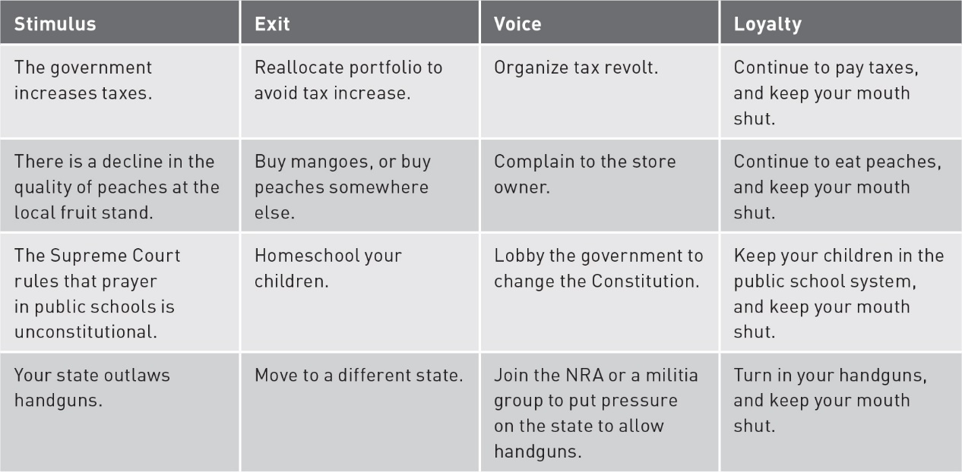
The Exit, Voice, and Loyalty (EVL) Theory of Politics
Notes:
Note the wide range of scenarios to which we can apply EVL.

Slide 10
The Exit, Voice, and Loyalty (EVL) Theory of Politics
Imagine that the government takes $1 from a citizen. In response, the citizen can:
Do nothing (LOYALTY): government keeps $1, citizen left w/ $0
Petition with a letter (VOICE): stamp costs $0.20, government might ignore it.
Move to Neighborland or Faraway Island (EXIT)
Some citizens can move to Neighborland where President Mr. Rogers gives them Universal Basic Income of $0.75.
Others only have the option to go to Faraway Island, at a cost of $0.25 for a loooong boat ride.

Slide 11
The Exit, Voice, and Loyalty (EVL) Theory of Politics
Government takes $1 from citizen.
If citizen chooses LOYALTY or EXIT, government has no other choice to make.
If citizen uses VOICE, government can:
Respond by giving $1 back—minus the cost of the petition—so the citizen is left w/ $0.80.
Ignore: petition is ignored and government keeps $1. Citizen still pays cost of petition, s/he gets –$0.20 (minus 20 cents!)

Slide 12
The Exit, Voice, and Loyalty (EVL) Theory of Politics
But, citizen could be worth more to the government than just the $1 it took.
How valuable is the citizen’s continued loyalty to the government?
Government gets money from digging ditches. So, citizen’s value has to do with how good they are at digging.
The loyalty of good diggers, like Sting, is more valuable than $1 –let’s say $2– so if they petitioned, the government would give the dollar back (RESPOND) if it prevented them from exiting…because they would give $1 to get $2!
The loyalty of bad diggers is worth less than $1—let’s say $0.50—so the government would prefer to keep the dollar (IGNORE) because they don’t care if the citizen exits.

Slide 13
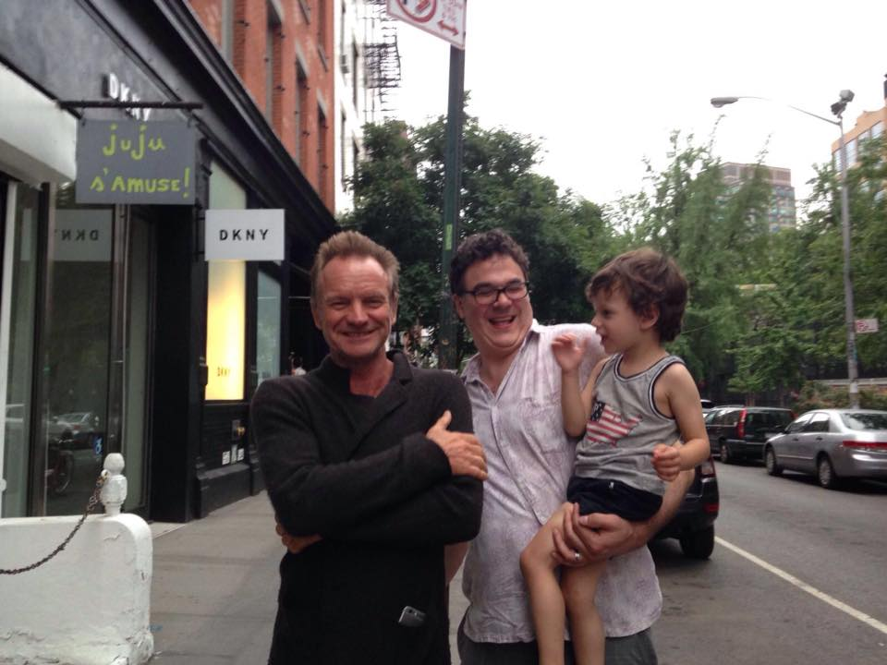

Slide 14
The Exit, Voice, and Loyalty (EVL) Theory of Politics
Think a little about how you would predict what the citizen and government would do.
What affects the citizen’s decision?
Whether they can go the Neighborland or Faraway Island—i.e. the value of their exit option.
What affects the government’s decision?
Whether the citizen is a good digger or a bad digger—or how much a citizen’s Loyalty is worth to them.

Slide 15
The Exit, Voice, and Loyalty (EVL) Theory of Politics
We have two values of Exit option:
High (E = $0.75; generally, E > 0)
Low (E = -$0.25; generally, E < 0)
We gave two values of Loyalty:
Good digger (L=$2; generally L > 1)
Bad digger (L=$0.50; generally L < 1)
This gives us 4 possibilities:
E > 0 ; L > 1
E < 0 ; L > 1
E > 0 ; L < 1
E < 0 ; L < 1

Slide 16
The Exit, Voice, and Loyalty (EVL) Theory of Politics
When thinking about strategic situations, it is helpful to map out the sequence of choices available to the actors involved.
Example: decision tree
Map of the possible outcomes of a series of related choices

Slide 17
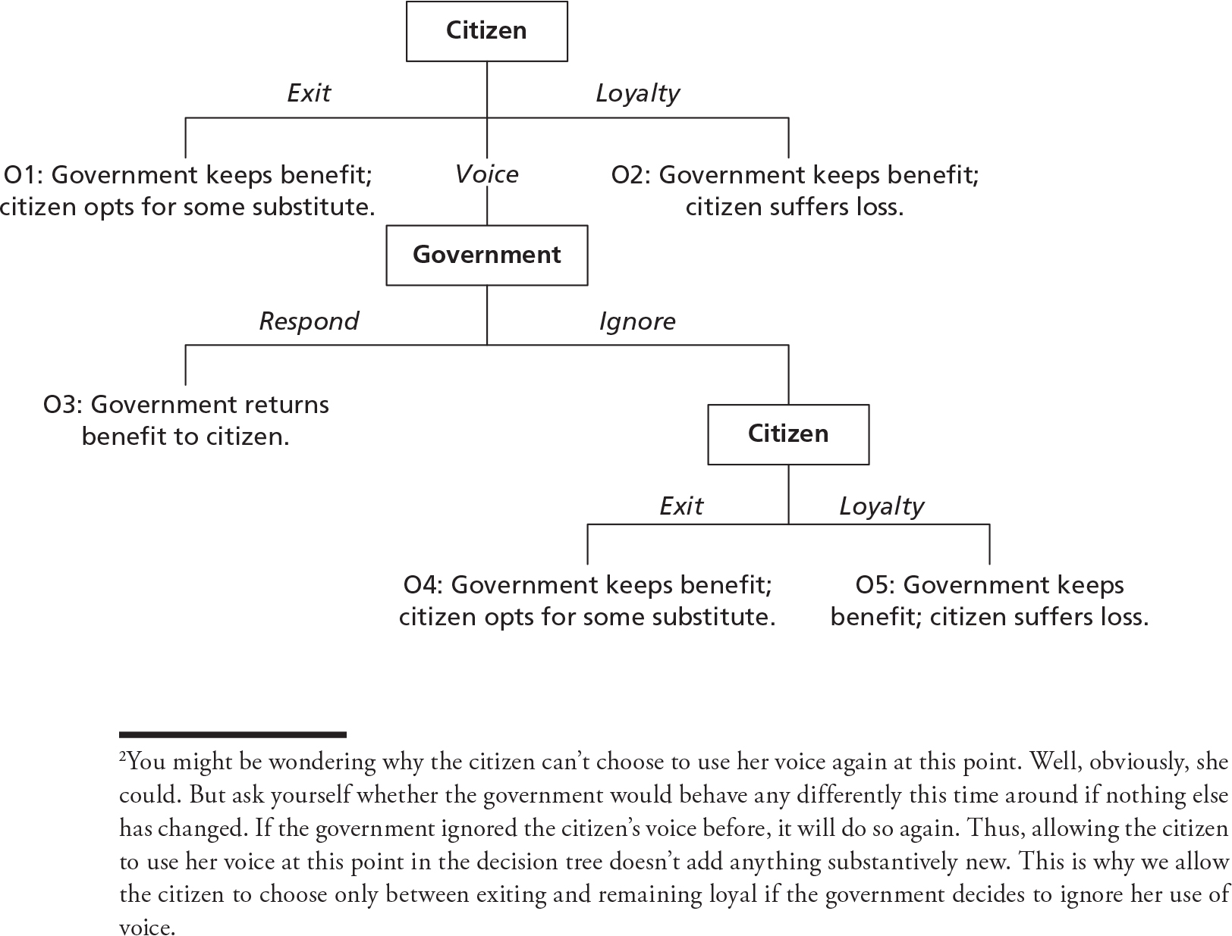
The Exit, Voice, and Loyalty (EVL) Theory of Politics

Slide 18
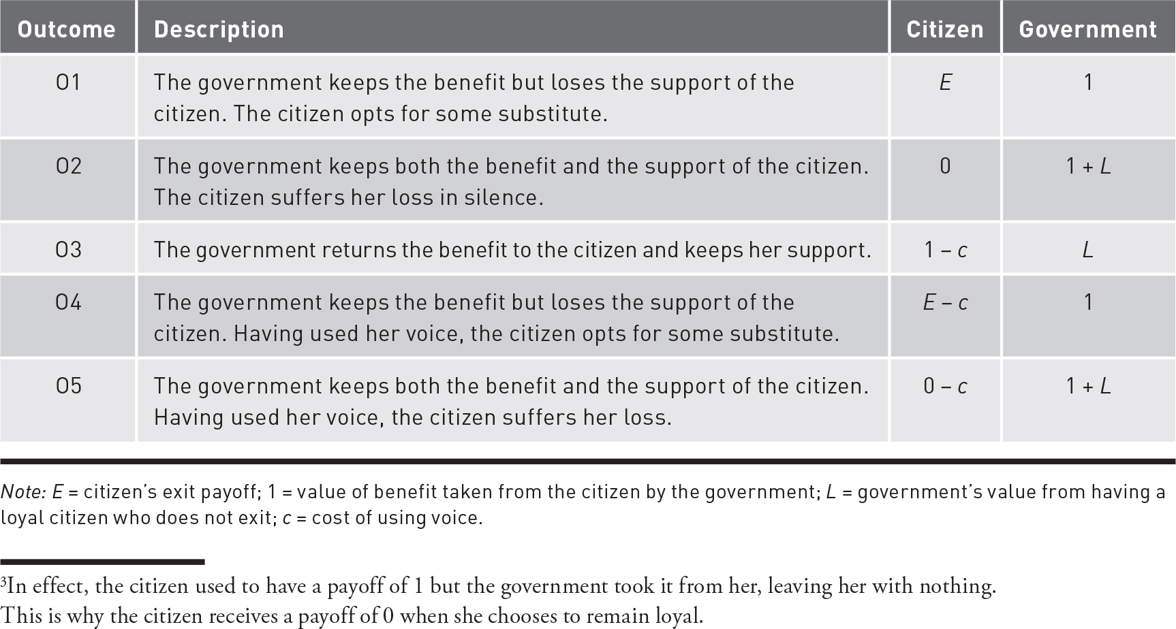
The Exit, Voice, and Loyalty (EVL) Theory of Politics
Five possible outcomes

Slide 19
The Exit, Voice, and Loyalty (EVL) Theory of Politics
If a citizen chooses to exit, they get an exit payoff: E
If a citizen chooses to remain loyal, they accept their loss and gets nothing: 0
If a citizen chooses use of voice, it will be costly: -C

Slide 20
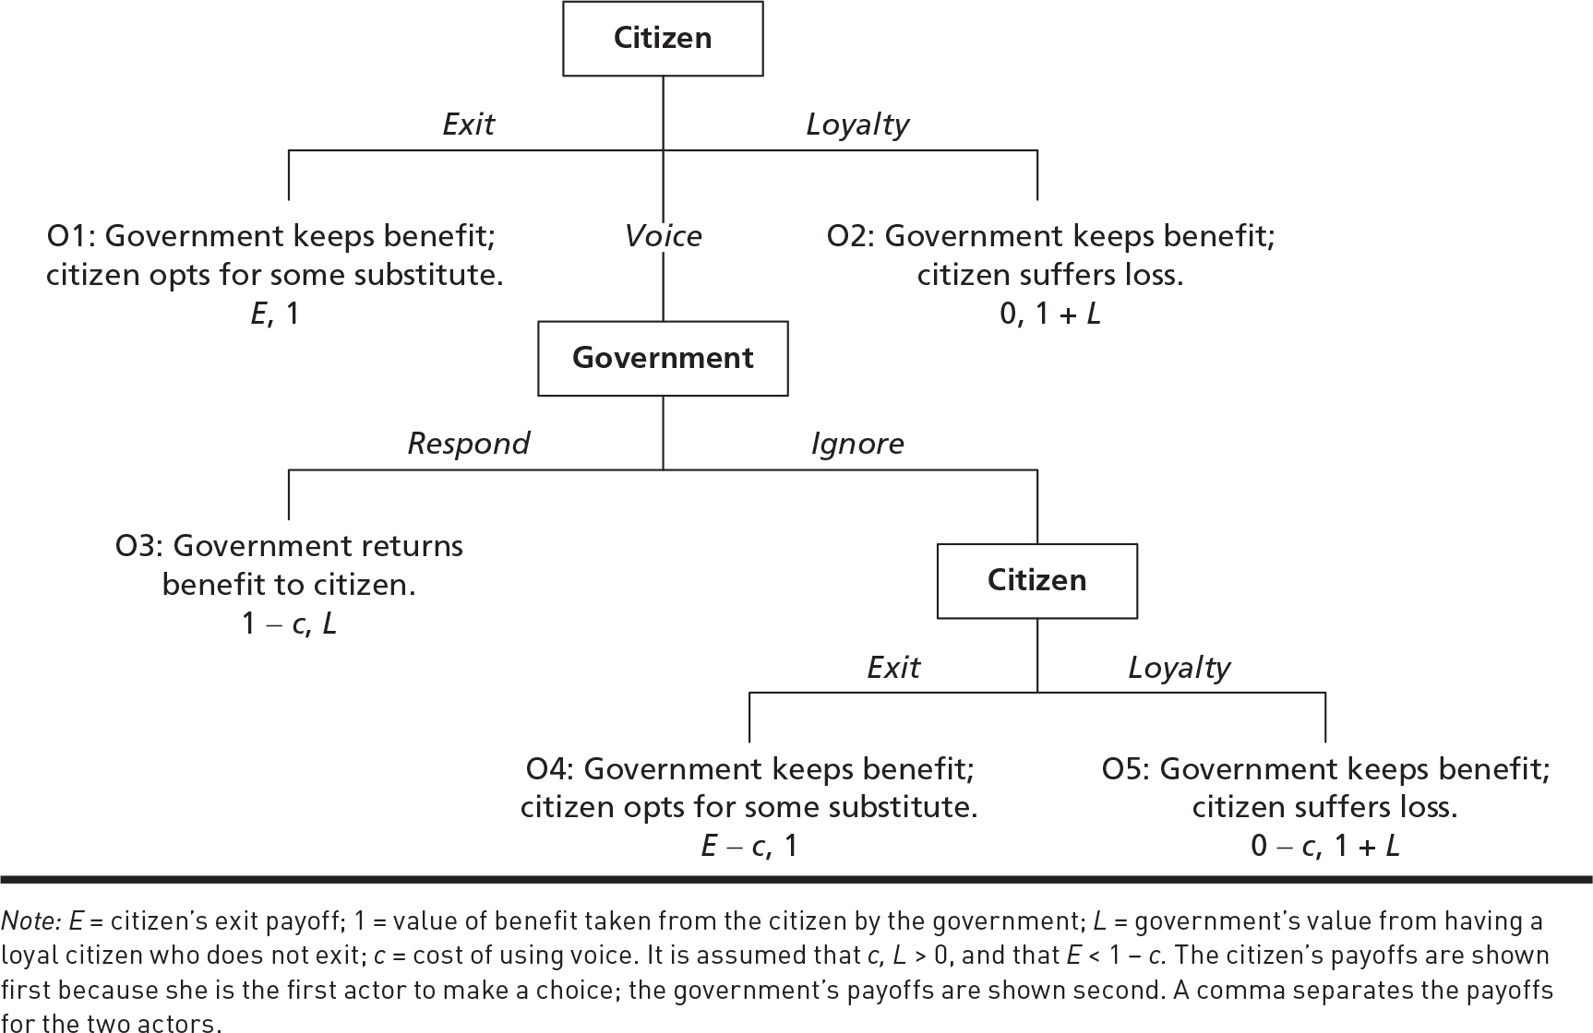
The Exit, Voice, and Loyalty (EVL) Theory of Politics
Payoffs:
Citizen, Gov.
(b/c citizen makes first choice their payoff listed first)
Notes:
For each outcome, there is a payoff for both players
The citizen makes the first choice in the decision tree so their payoff is listed first for all outcomes; the government’s payoffs are shown second.

Slide 21
The Exit, Voice, and Loyalty (EVL) Theory of Politics
One assumption has to be made:
The value the citizen gets from exiting (O1) is less than the value they get from successfully using their voice and regaining the benefit taken by the government (O3).
If we don’t make this assumption, then citizen would exit every time and game wouldn’t be interesting.

Slide 22
What Happens in the EVL Theory
Goal is to say something about what we expect the citizen and government to do.
Actors will anticipate how the other actors will respond to their choices
Actors begin by looking at the end of the game: backward induction

Slide 23
What Happens in the EVL Theory
Backward induction requires starting at the bottom/end of the decision tree and working our way to the top/beginning.
The last choice in the decision tree sees the citizen deciding whether to exit or remain loyal.
What should the citizen do?
Notes:
Let’s assume that the citizen’s exit payoff is greater than their loyalty payoff. We can think that the citizen has a credible exit threat in this scenario as they prefer to exit rather than remain loyal.

Slide 24
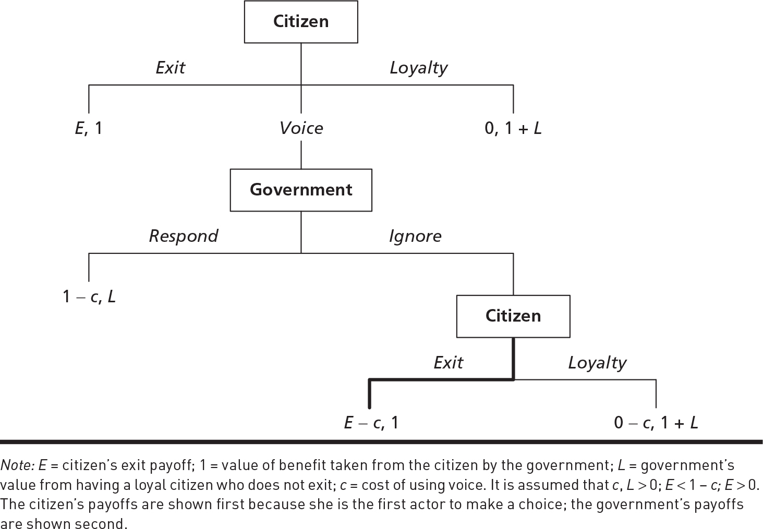
What Happens in the EVL Theory
Scenario 1:
E > 0 ; L > 1

Slide 25
What Happens in the EVL Theory
The government has to decide whether to respond positively to the citizen or ignore them
If the government responds positively, it receives a payoff of L.
If the government ignores the citizen, it can look down the tree and anticipate that the citizen will exit and, if so, their payoff will be 1.
Notes:
We can think that the government is dependent on the citizen in this scenario as it values the citizen’s loyalty more than the benefit it took from them.

Slide 26
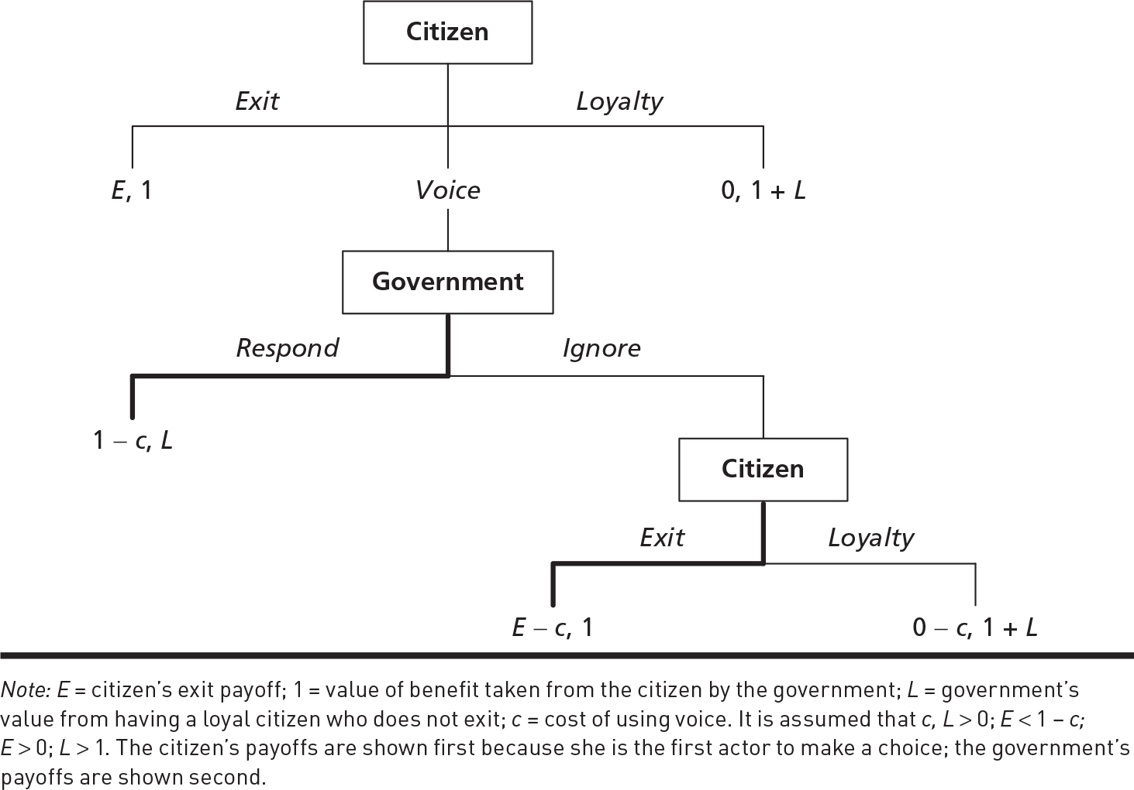
What Happens in the EVL Theory
How will the government respond?
Scenario 1:
E > 0 ; L > 1
Notes:
The government will respond positively to the citizen’s use of voice.

Slide 27
What Happens in the EVL Theory
Now the citizen must decide whether to exit, remain loyal, or use their voice.
If choosing to exit, they receive a payoff of E.
If choosing to remain loyal, they receive a payoff of 0.
If choosing to use their voice, they can look down the decision tree and anticipate that the government will respond positively; their payoff will be 1 – c.

Slide 28
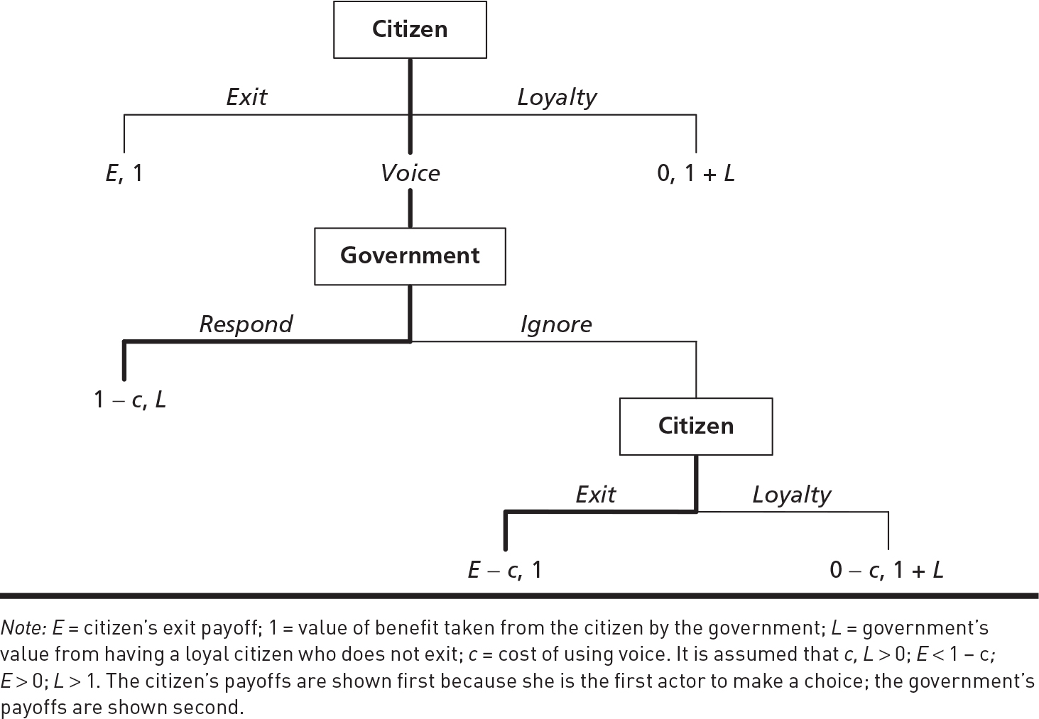
What Happens in the EVL Theory
What will the citizen decide?
Scenario 1:
E > 0 ; L > 1

Slide 29
What Happens in the EVL Theory
This analysis focuses on the scenario where the citizen has a credible exit threat (E > 0) and the government is dependent (L > 1).
What happens if we change the scenario?
If we retain the assumption that the government is dependent (L > 1), but now assume that the citizen lacks a credible exit threat (E < 0)?

Slide 30
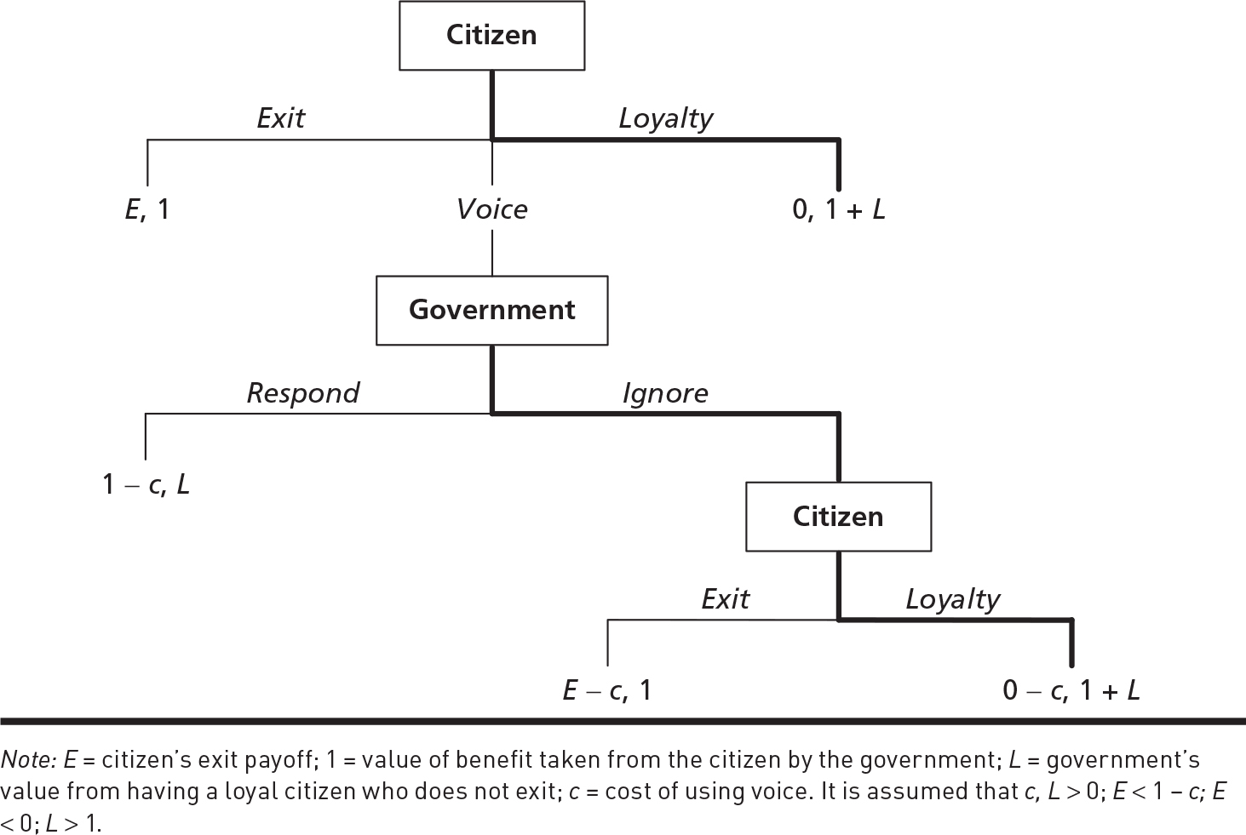
What Happens in the EVL Theory
Scenario 2:
E < 0 ; L > 1
Notes:
In this scenario, the citizen is powerless and must simply live with the government policy they do not like

Slide 31
What Happens in the EVL Theory
A third scenario: The citizen has a credible exit threat (E > 0) but the government is autonomous and does not depend on the citizen (L < 1).
Notes:
An autonomous government is one that values what it took from the citizen (1) more than the citizen’s loyalty (L).

Slide 32
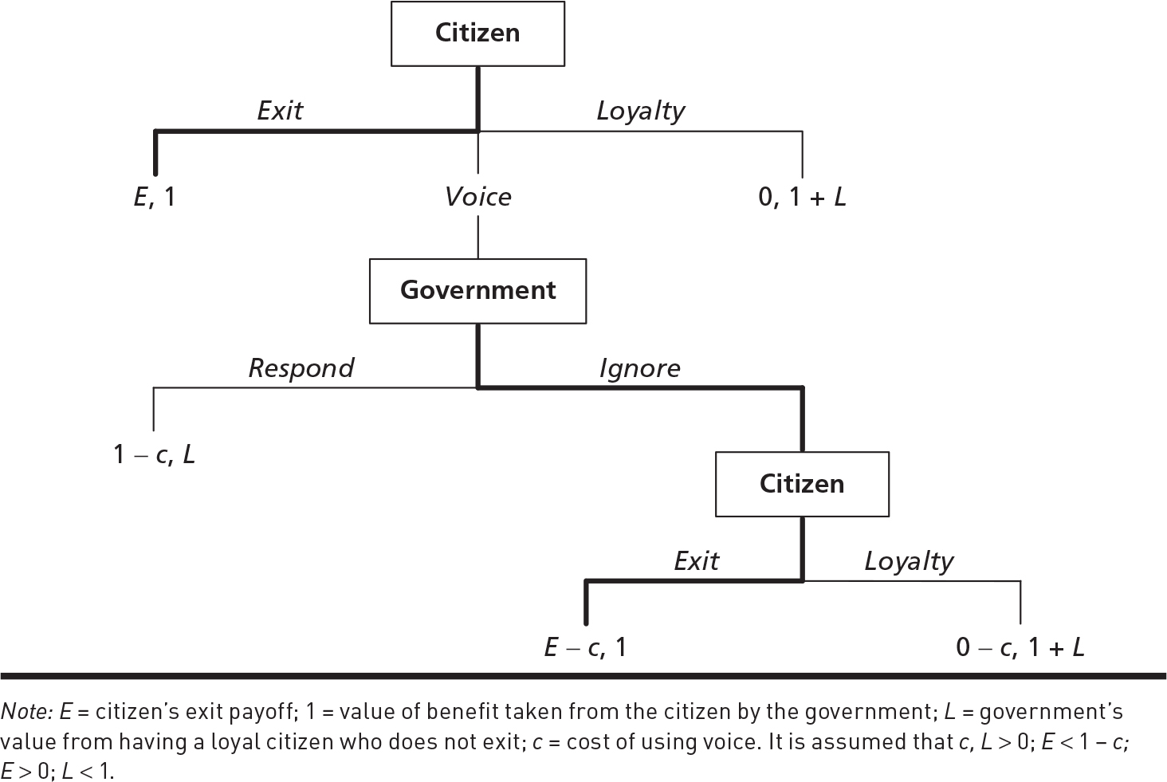
What Happens in the EVL Theory
Scenario 3:
E > 0 ; L < 1
Notes:
In this scenario, the citizen is powerless and cannot get the government to retract the policy they do not like.

Slide 33
What Happens in the EVL Theory
Last scenario: What happens if we assume the citizen lacks a credible exit threat (E < 0) and the government is autonomous (L > 1)?

Slide 34

What Happens in the EVL Theory
Scenario 4:
E < 0 ; L > 1
Notes:
The citizen is powerless and must simply live with the government policy they do not like.

Slide 35
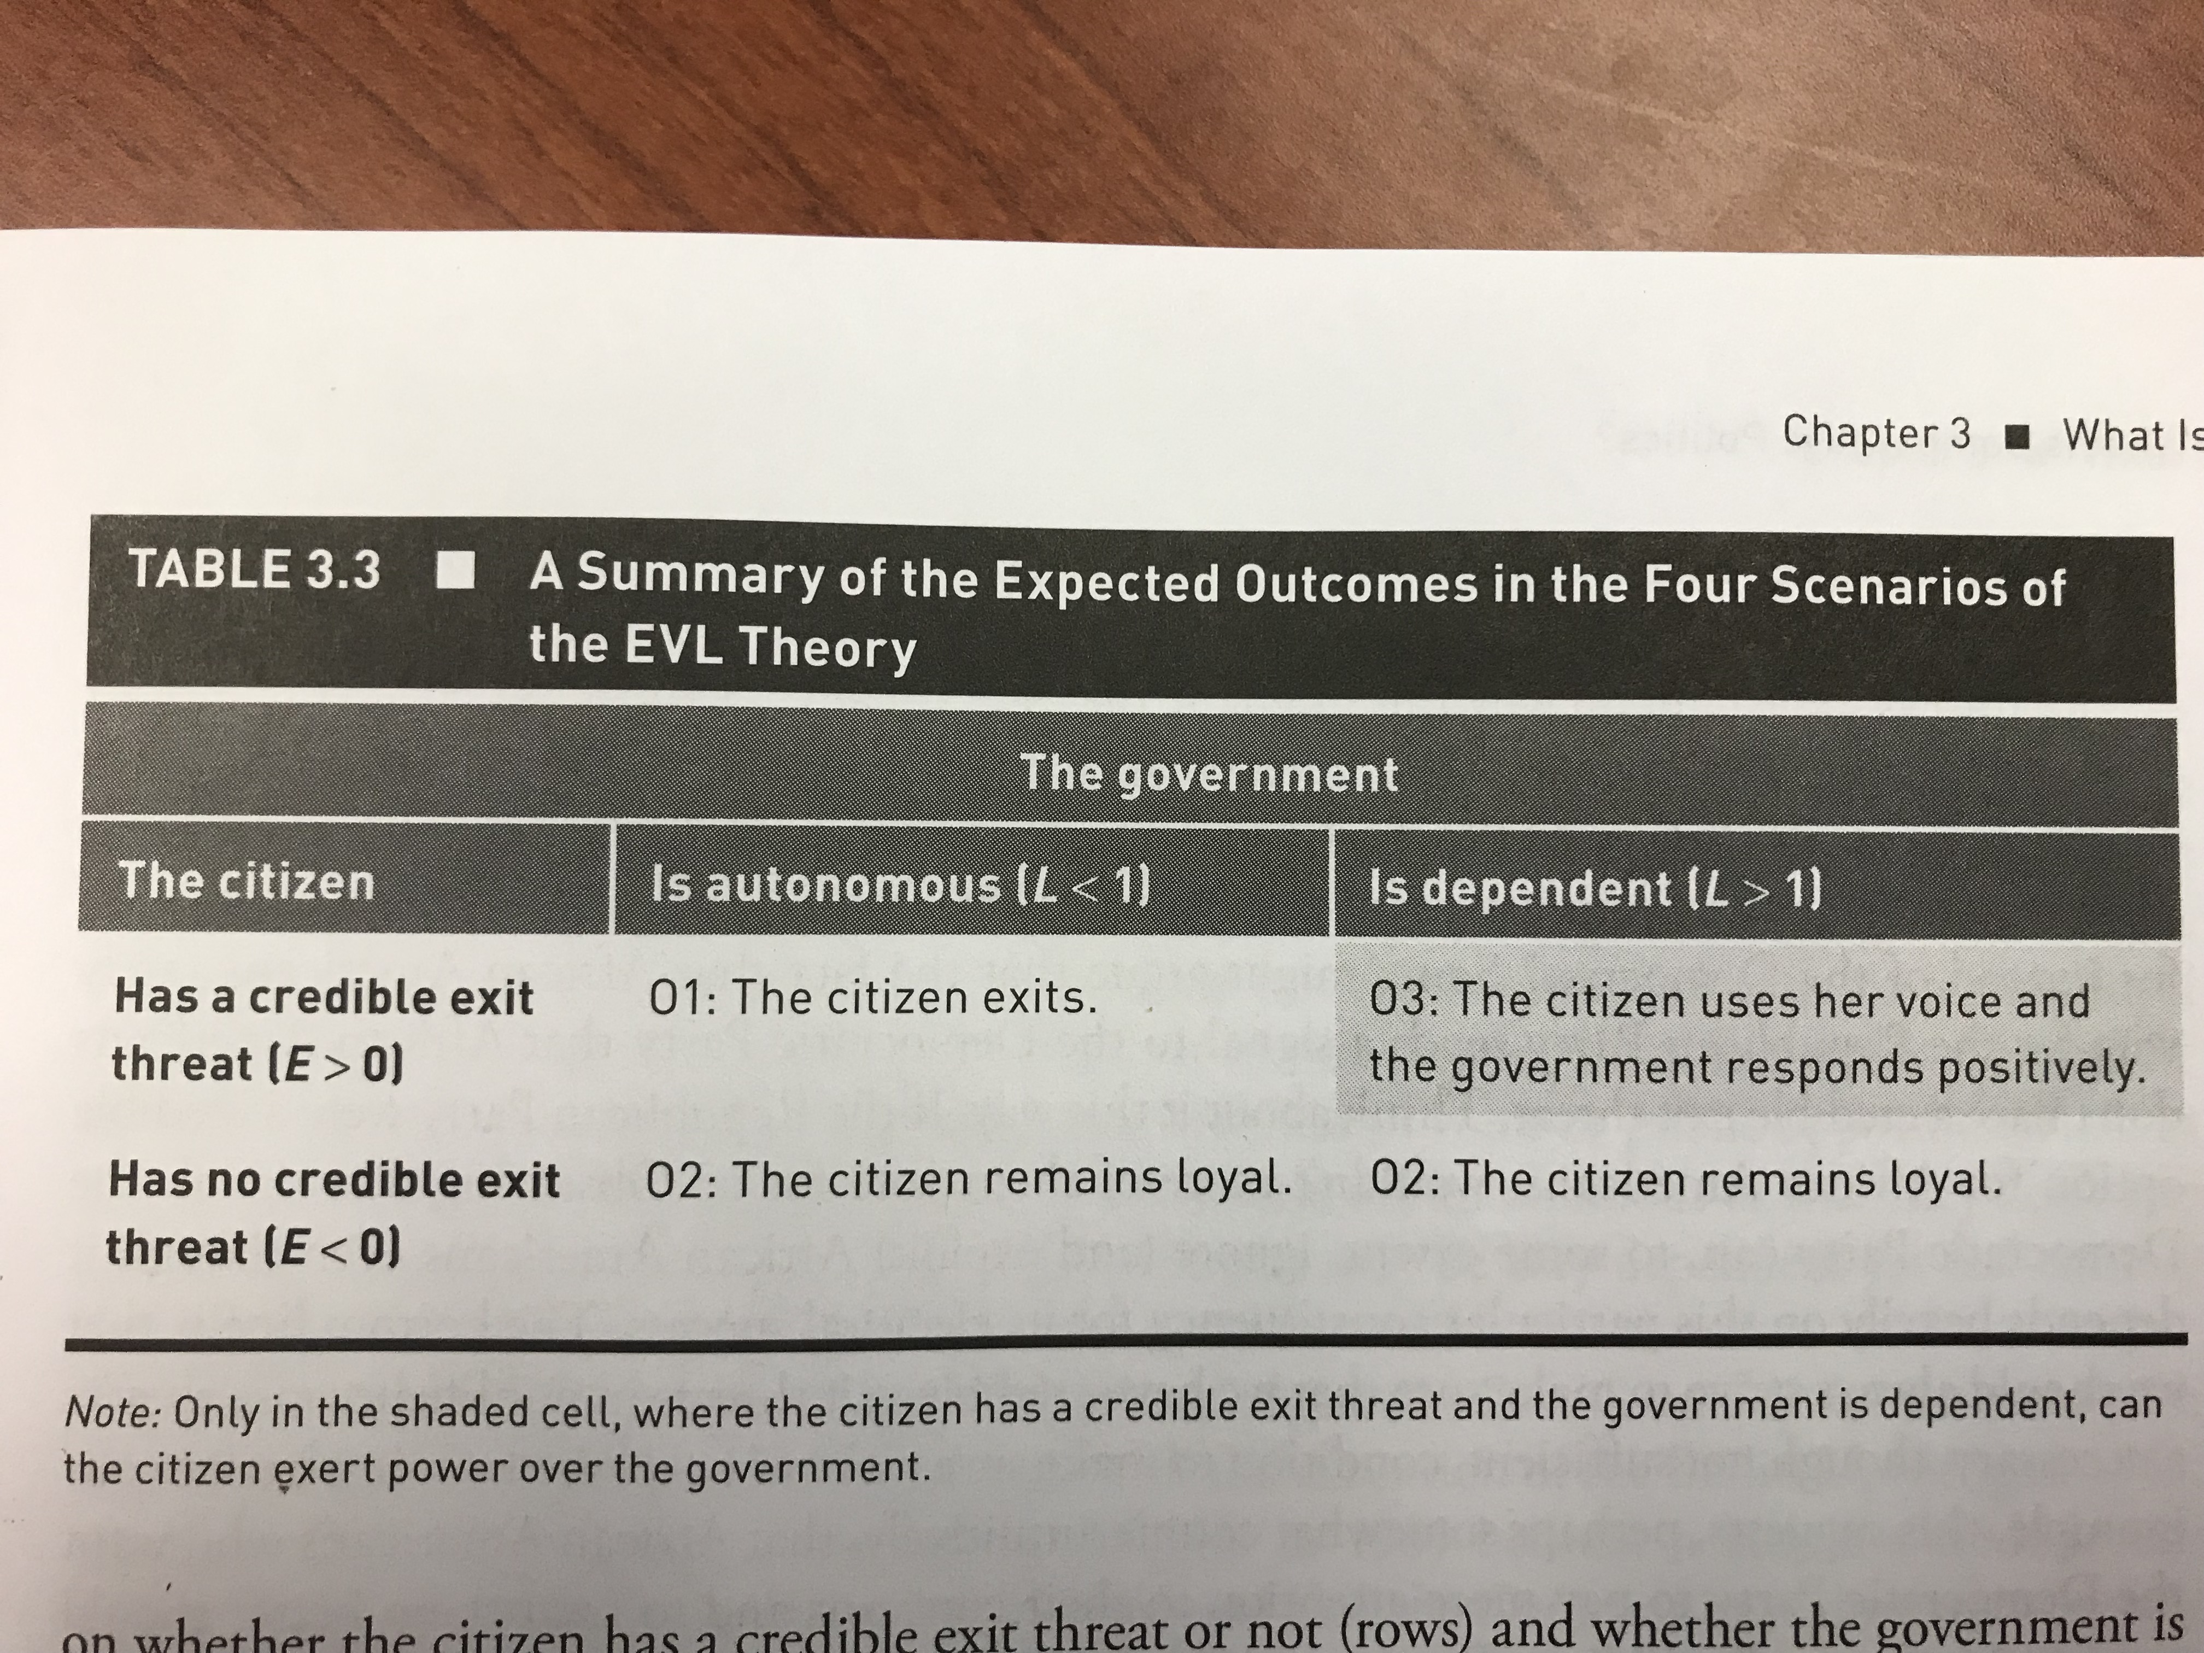

Slide 36
Insights From the EVL Theory
The citizen is able to exert power over the government only when:
The citizen has a credible exit threat,
AND!
The state is dependent on the citizen.
Both of these things must be true. Otherwise the state has no incentive respond to the voice of the citizen
If the citizen does not have a credible exit threat, then she is a sitting duck!
The state can take things from the citizen and the citizen can do nothing about it…even the state is dependent on the citizen (the citizen is valuable to the state)

Slide 37
Insights From the EVL Theory
It is difficult to learn very much from observing real-world political situations.
If voice was going to be effective, why would the state have taken the benefit away from the citizen in the first place?
The theory cannot explain why we sometimes see governments being unresponsive to the demands of their citizens.
Under the theory there are multiple ways in which we can observe such an outcome; it is “overdetermined”

